Slide 1
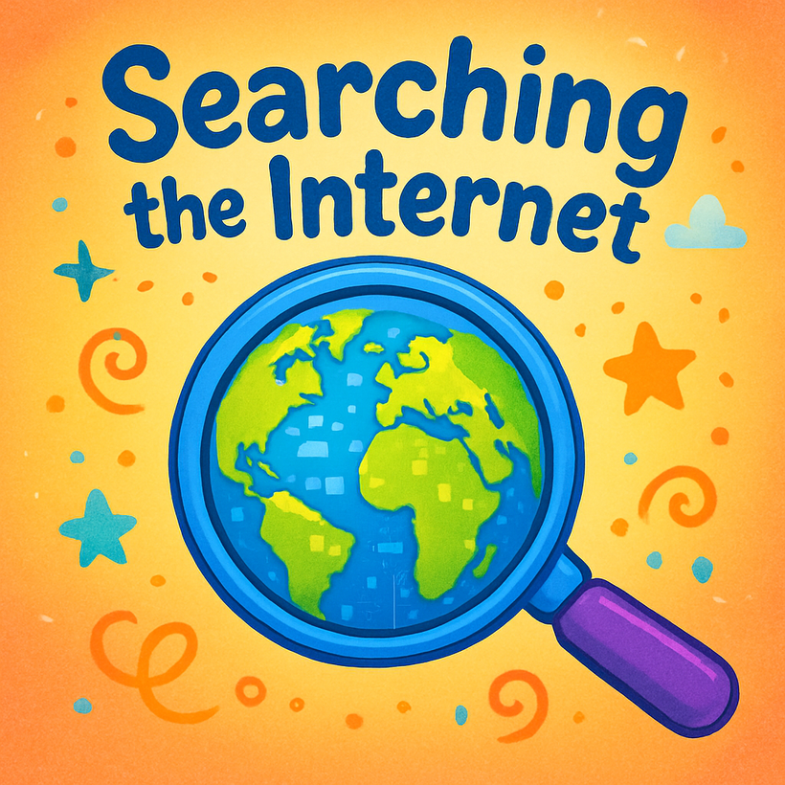
chapter 5

Slide 2
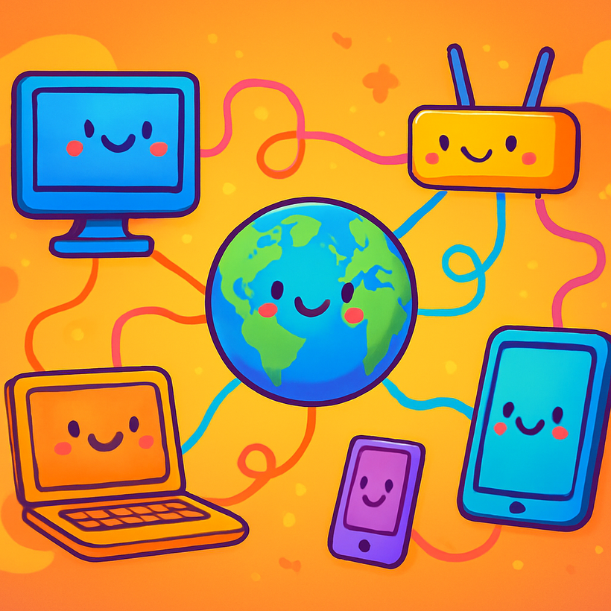
What is the Internet?
A global network connecting millions of computers.

Slide 3
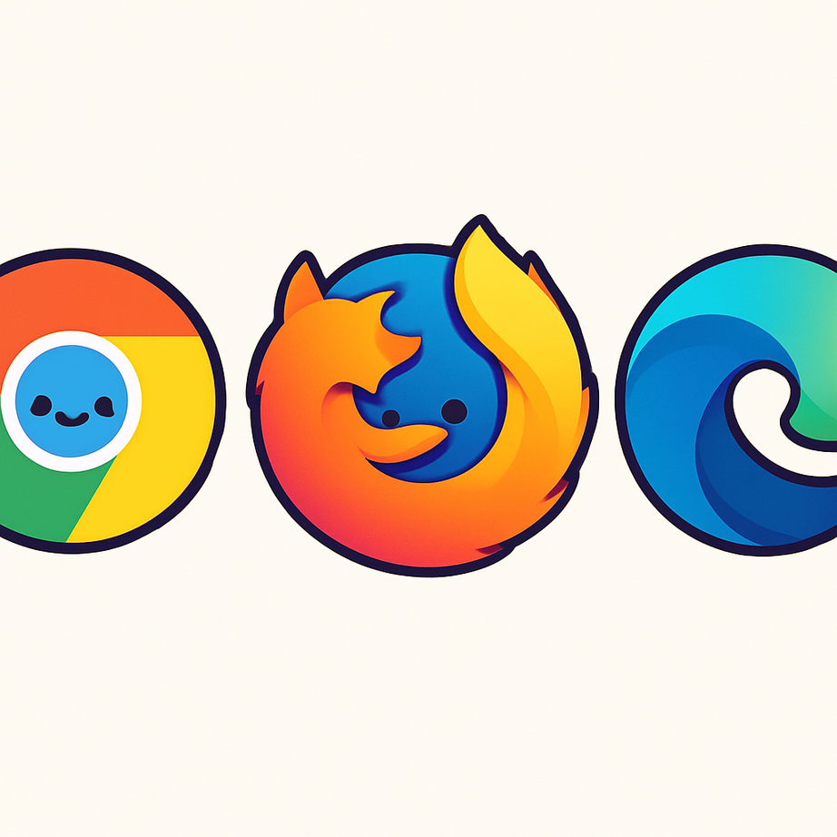
Web Browsers
Tools to open websites

Slide 4
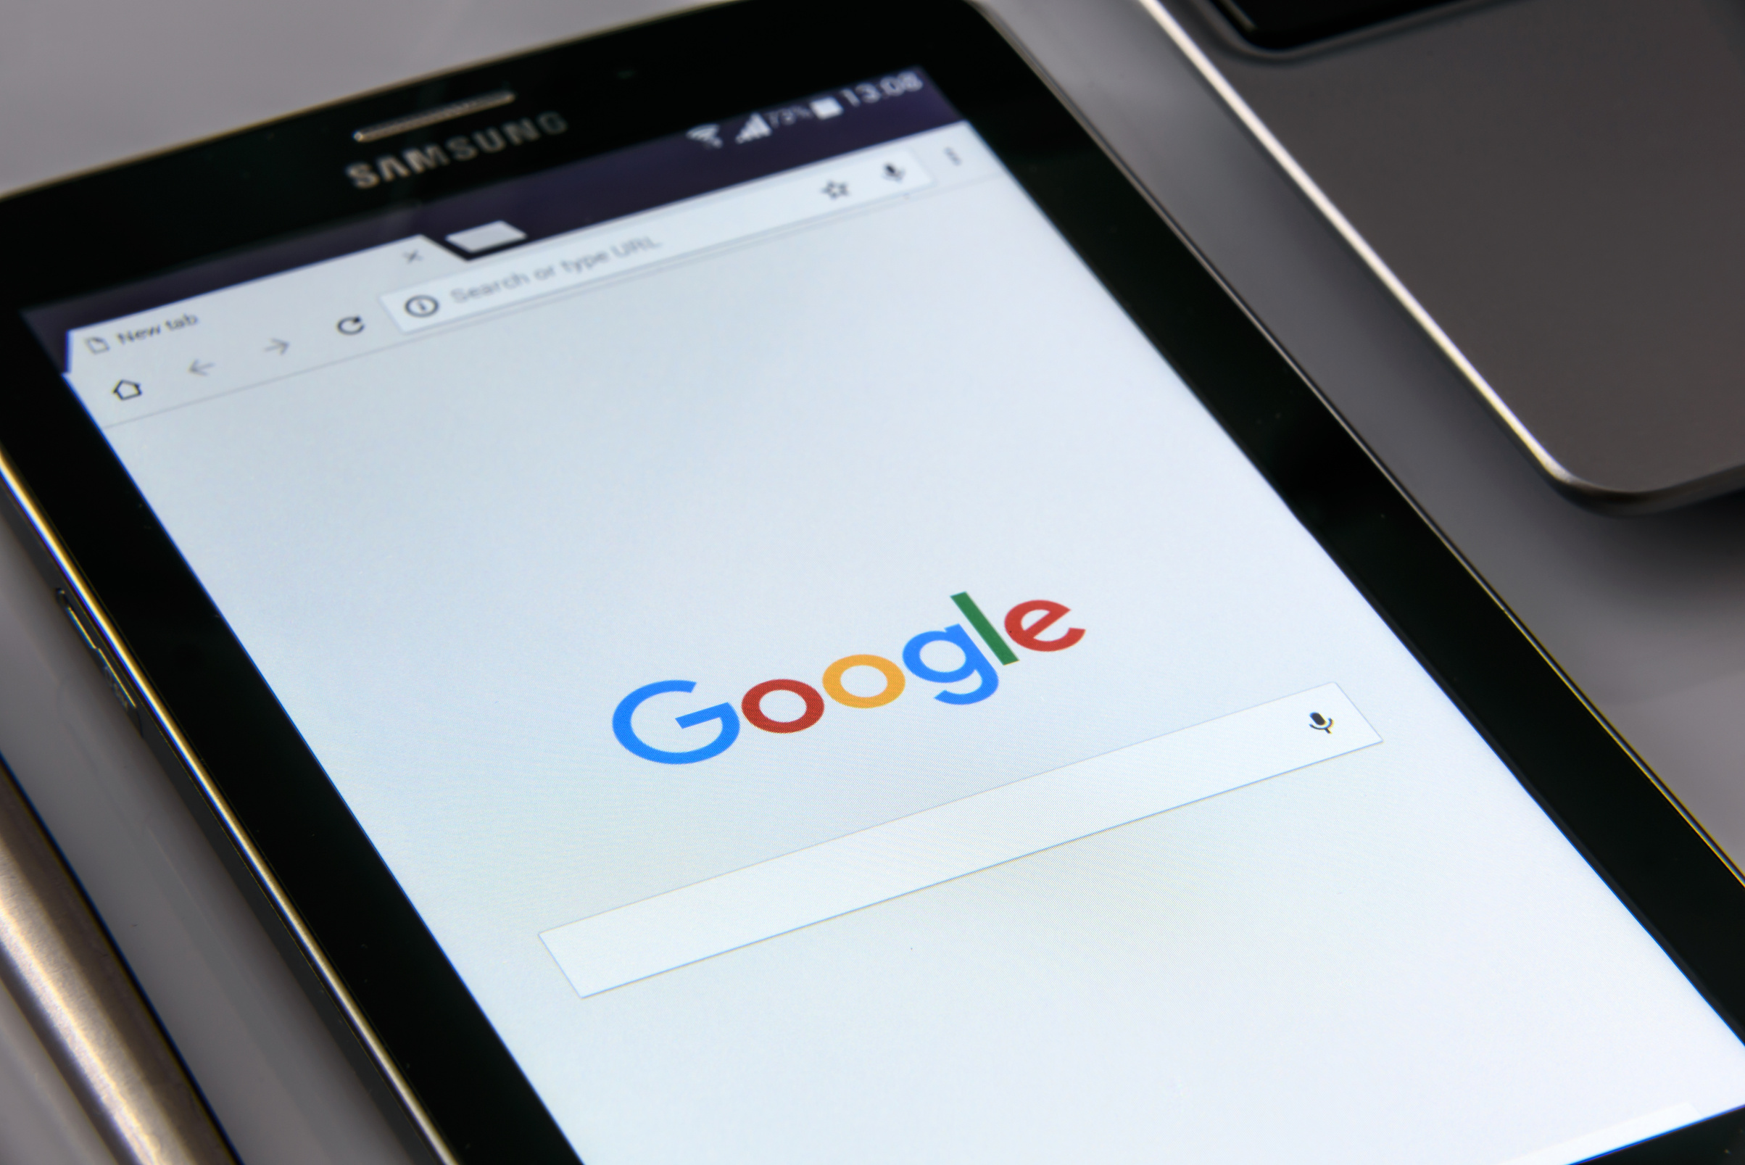
Search Engines
Helping you find information quickly

Slide 5
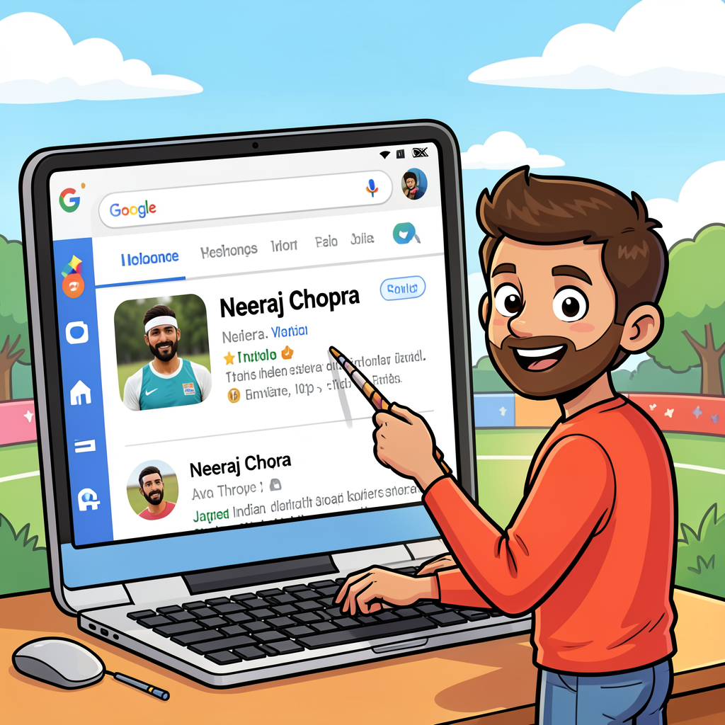

Slide 6

What is Wikipedia?
🌍 A giant digital book of facts.
📚 Free for everyone to read.
🤝 Written by people all over the world.

Slide 7
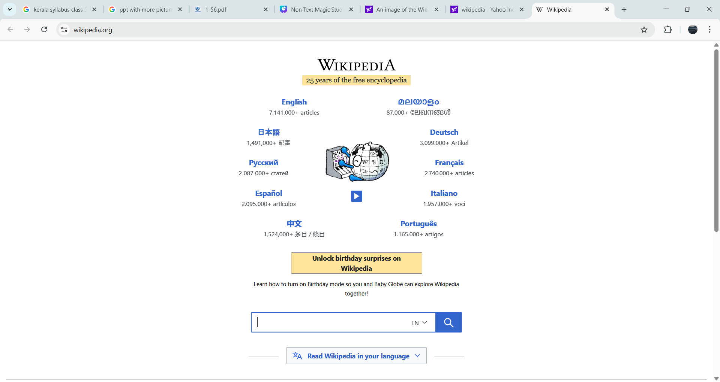

Slide 8
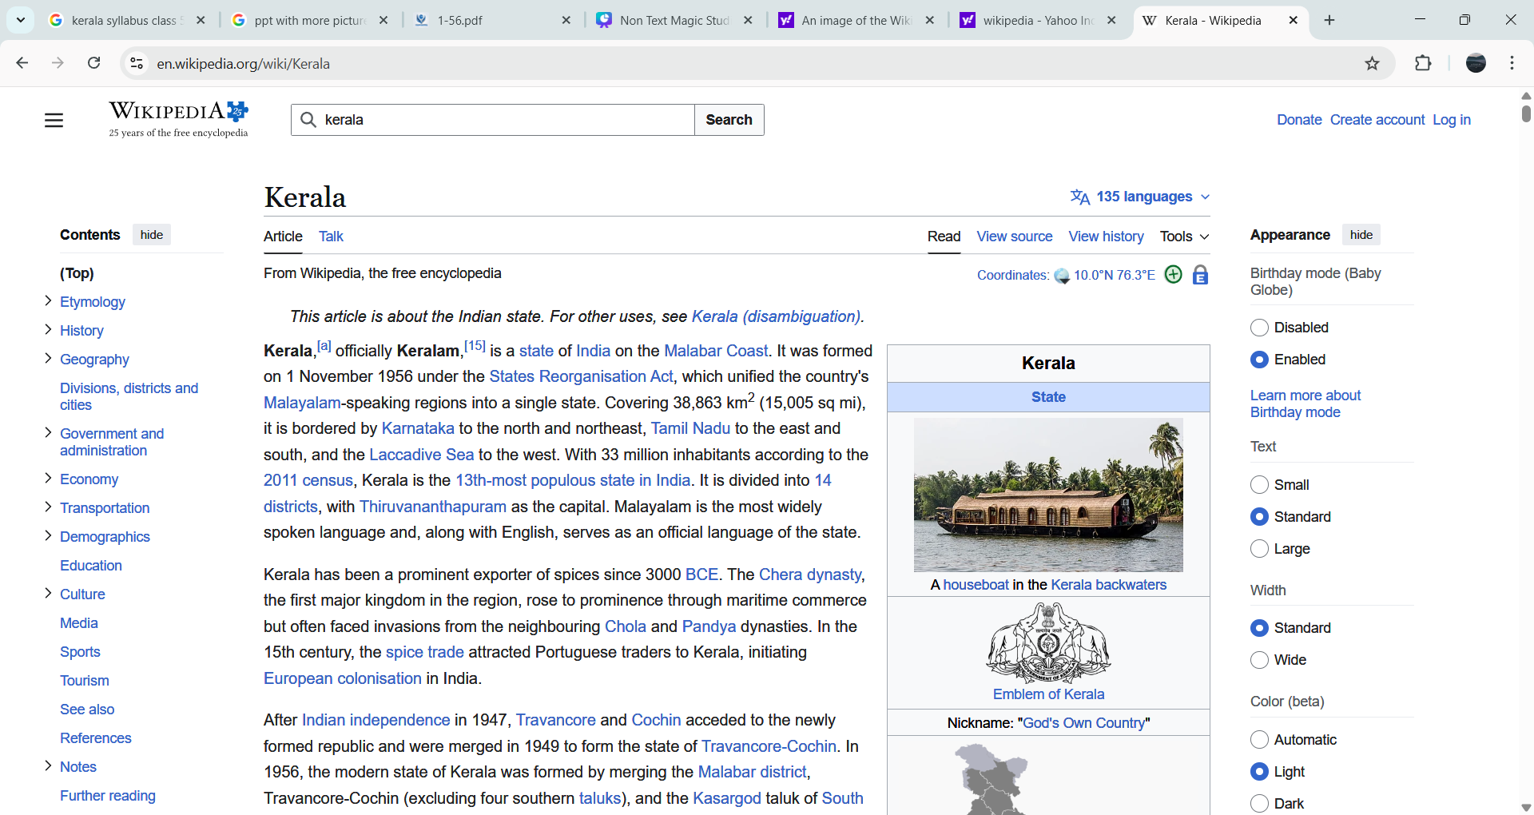

Slide 9
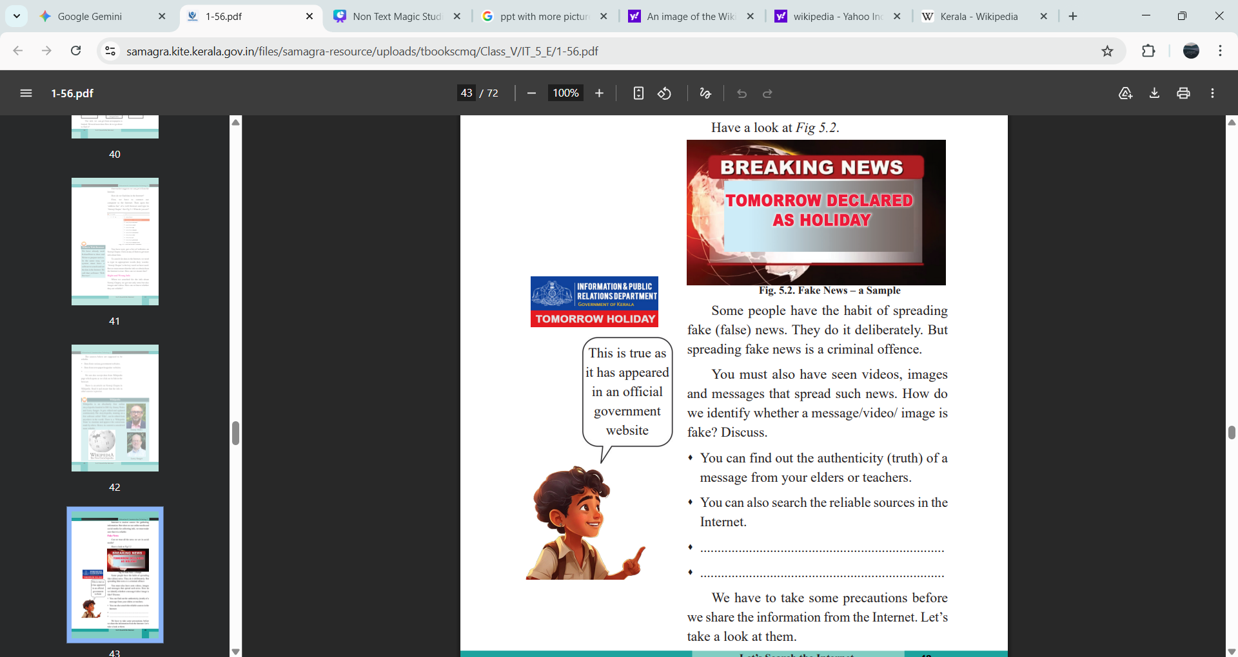
Real vs. Fake (Is it True?)

Slide 10
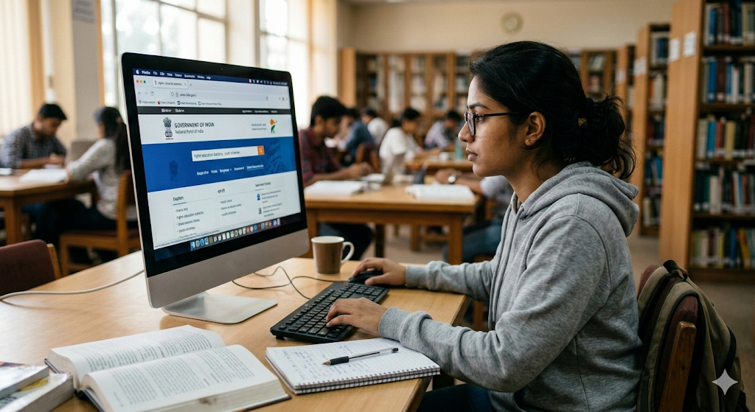
How to Fact-Check
Search official sites: Check the Kerala Education Department for school holidays instead of believing messages.
Multiple Sources: If only one person says it, it might be fake. If everyone (like Wikipedia or major news) says it, it is likely true.

Slide 11
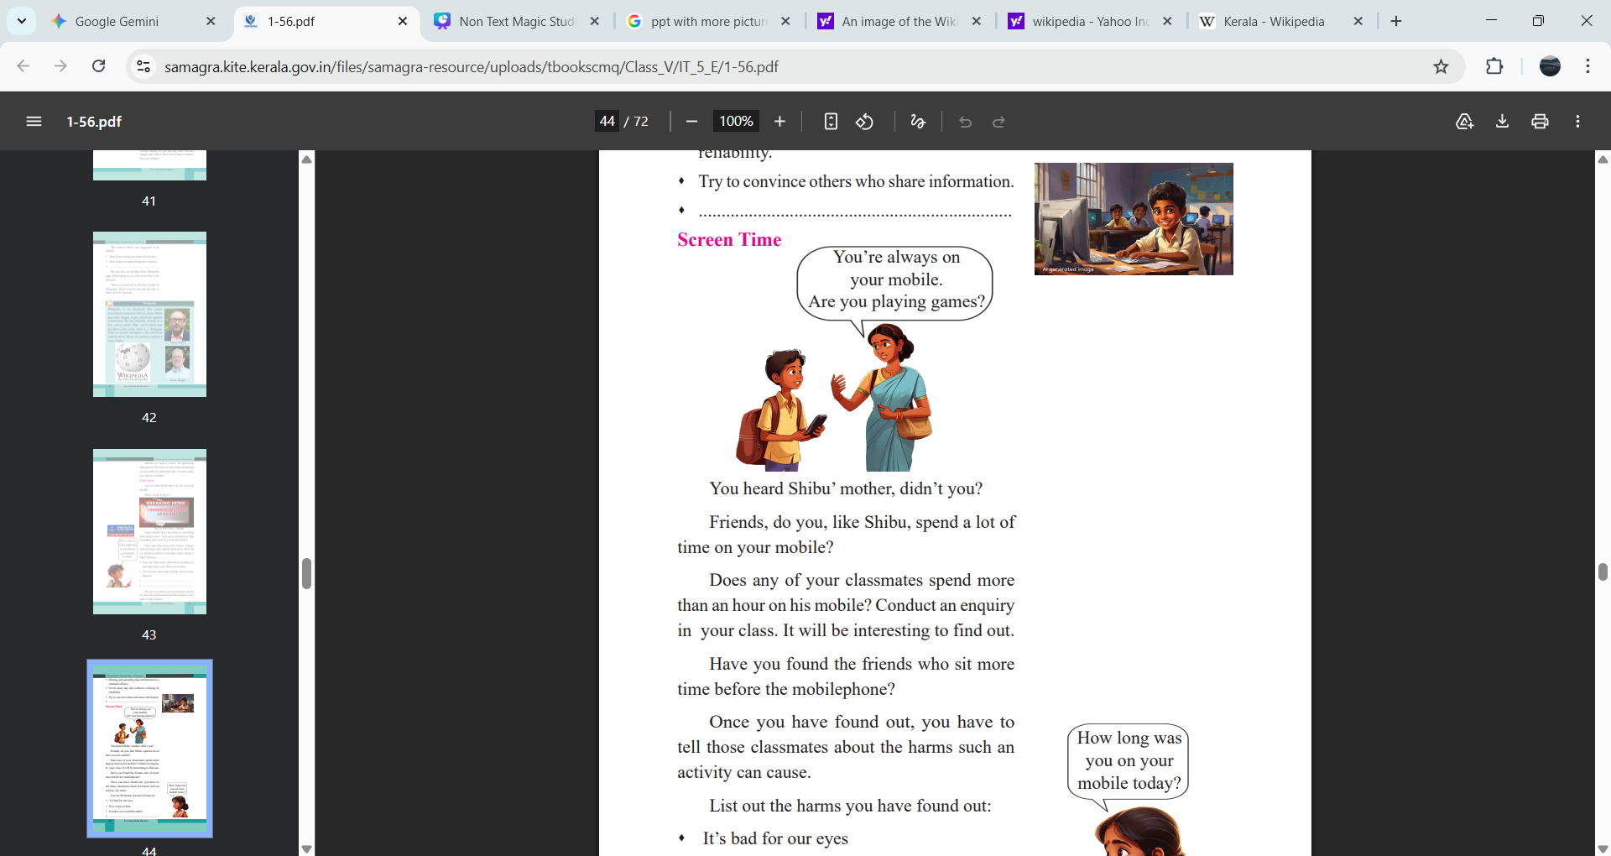
List out the harms you have found out:
⬧ It’s bad for our eyes
⬧ It’s a waste of time
⬧ It makes you a mobile-addict

Slide 12
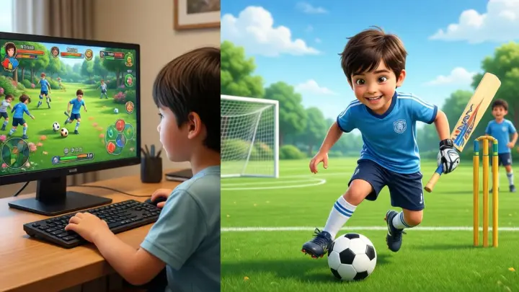
Digital welbeing
Balance screen time with outdoor play for a healthy body.

Slide 13
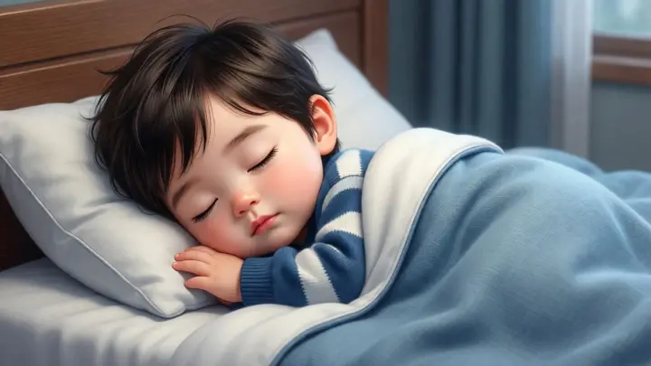
No screens 1 hour before bed.
Blue light from screens "wakes up" your brain and stops you from sleeping well.

Slide 14
